Slide 1

Stage 6 Boxed Out Modified Course Designer: Arthur Wang
Boxed Out Modified (inspired by Inland Empire Boxed Out stage) is a 20 round, 100 point, COMSTOCK Medium course. There are 10 USPSA targets. The best 2 hits per target will score.
The Handgun start position is standing outside of shooting area with feet touching start stick and wrists below belt. Handgun is loaded and holstered. PCC start position is standing outside of shooting area with feet touching start stick, stock on belt and safety on.
On the audible start signal, engage all targets from within the shooting area.

Slide 2
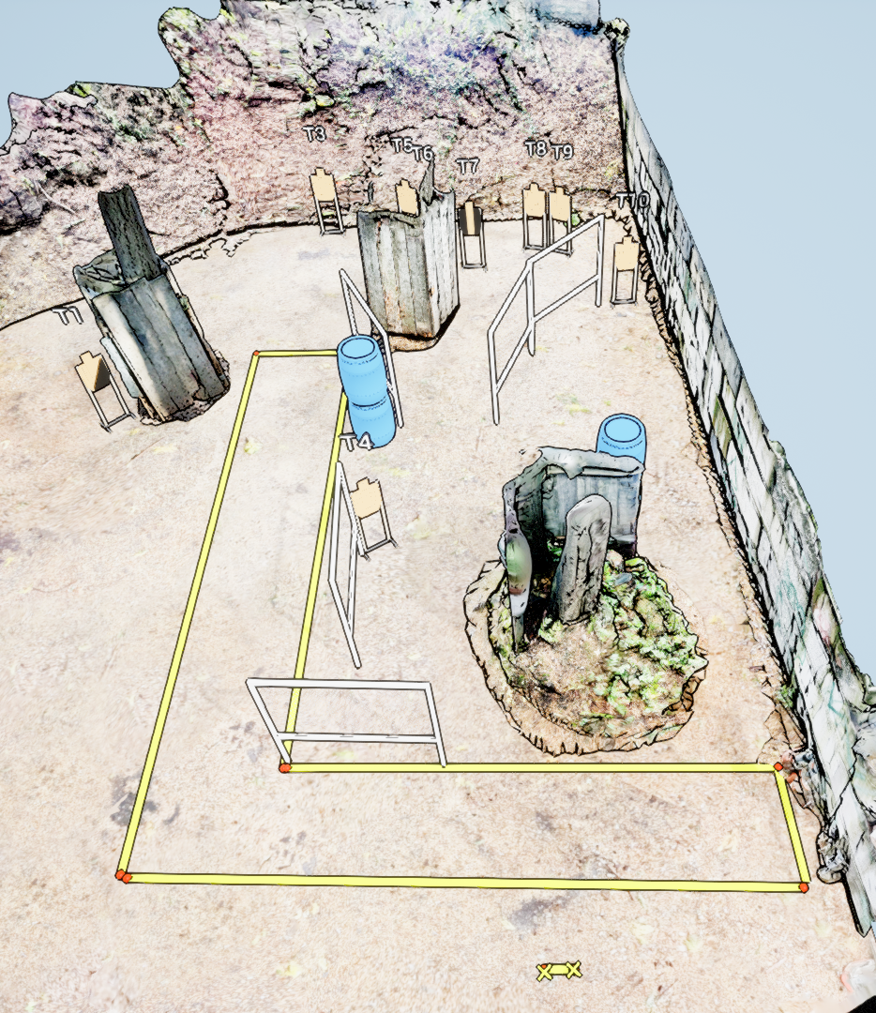
 | Stage 6 Boxed Out Modified Course Designer: Arthur Wang

